Slide 1

CAUSAL INFERENCE OF PRODUCT PACKAGING IN BRAND COMMUNICATIONS
PRESENTED BY--

Slide 2

INTRODUCTION OF THE STUDY
Packaging vitally builds and contributes to the core of product marketing, bridging the symmetry in the branding process as it plays a crucial role in communicating the image and identity of a brand.
This case study transparently produces a guiding light towards highlighting and underlining the important packaging attributes responsible for brand symphony and orchestra of communication such as: Package Design, Liking for Package, Communication through Package and Usability of Package from customer’s point of view.
Multiple regressions were carried out as a part and parcel of causal inference model, to find the significant relationship between the variables through self-administered data collection on 10 point Likert scale from 100 customers.
Further propensity scores were determined and DID analysis was performed on 20 customers through for different products at hand to understand the responsiveness of the consumer awareness.
The result reconfirms and re-affirms packaging as an important tool to influence and communicate the brand and it’s IMAGE to the consumers in the marketplace and marketspace.

Slide 3
Role of Packaging in Creating Brand Identity
Product packaging designs are a critical component in building a brand’s image as it can erase or mark the brand’s identity. Its helpful in following ways:
Brand Identity Expression – Packaging engages users and glows a setting apart stage for a brand in today’s crowded and competitive markets.
Relationship Building - Packaging is the building brick and block of the onset of a relationship between a brand and the end user.
Communication - Good package design makes information handsomely available to consumers and concretely holds the nerves of the feet on the ground.
Selling - The regular interaction with the quality packaging envelops as a tool to sell the product easily in the market.
Protection - Better quality packaging provides better protection to the products & enhances its brand identity.

Slide 4
Research Framework
Dependent Variables
Based on careful investigation of available literature this research identified the following framework
Package design | Liking for package | Communication through Package | Usability of package
Attraction of buyer | Brand | Color | Ease of handling
Communication to the buyer | Country of origin | Symbols/logo | Disposability
Convenience in handling and using | Color connotation | Information about product | Moisture Protection
Salability of product | Symbol connotation | Brand image | Protection from ultraviolet radiation
Green aspect | Size | Shape
Independent Variables

Slide 5

Research Methodology
Multiple linear regression has been used to explain the relationship between one dependent variable and two or more independent variables as identified.
Propensity score analysis of 20 consumers was done and comfirmed the results using DID analysis. The average conversion rate of customers was used to determine the likeability of the selected products.
Sampling population consisted of the different users of packaging in the city of New Jersey and Delhi and over survey and zoom interviews who use the packaging in their day to day life.
Sampling size: 100 respondents for multiple regression analysis +20 respondents for propensity score analysis and DID analysis.

Slide 6
Multiple Regression Analysis for Package Design
Model | Unstandardized coefficients |  | Standardized coefficients
 | B | Std. Error | Beta | t | Sig.
1 (constant) | 2.254 | .458 |  | 4.921 | .000
Buyer attraction | .207 | .069 | .313 | 3.019 | .003
Communication | .173 | .092 | .171 | 1.892 | .061
Convenience | .173 | .054 | .295 | 3.185 | .002
Sale ability | -.017 | .064 | -.026 | -.265 | .791
Environmental factors | .051 | .043 | .106 | 1.179 | .241
Findings - The above table exhibit the significant relationship of Package design with Buyer attraction, Communication and Convenience of the product.

Slide 7
Multiple Regression Analysis for Liking of Package
Model | Unstandardized coefficients |  | Standardized coefficients
 | B | Std. Error | Beta | t | Sig.
1 (constant) | 2.362 | .571 |  | 4.134 | .000
Brand | -.300 | .094 | -.313 | -3.186 | .002
Country of Origin | -.068 | .127 | -.054 | -.538 | .592
Colour | .180 | .109 | .194 | 1.652 | .028
Smbols/Logos | .000 | .081 | .000 | -.002 | .998
size | .296 | .078 | .367 | 3.785 | .000
Findings - The above table exhibit the significant relationship of Liking of Package with Brand, Colour and Size of the Product.

Slide 8
Multiple Regression Analysis for Communication through the Package
Model | Unstandardized coefficients |  | Standardized coefficients
 | B | Std. Error | Beta | t | Sig.
1 (constant) | 2.214 | .514 |  | 4.311 | .000
Information | .113 | .074 | .178 | 1.522 | .031
Shape | .320 | .103 | .300 | 3.121 | .002
Brand Image | .119 | .118 | .019 | .158 | .022
Symbols/Logos | -0.41 | .073 | -.057 | -.561 | .576
Findings - The above table exhibit the significant relationship of Communication through Package with Information, Shape and Brand image of the Product.

Slide 9
Multiple Regression Analysis for Usability of the Package
Findings - The above table exhibit the significant relationship of Usability of the Package with Ease of handling and Protection of the Product.
Model | Unstandardized coefficients |  | Standardized coefficients
 | B | Std. Error | Beta | t | Sig.
1 (constant) | 1.818 | .465 |  | 3.911 | .000
Ease of handling | .350 | .065 | .477 | 5.371 | .000
Disposability | .043 | .060 | .063 | .720 | .473
Protection | .113 | .085 | .118 | 1.322 | .039

Slide 10
Matching and propensity score evaluation
Single Matching variable here is the hypothesis or an assumption ,that causal inference is tested on the consideration that packaging is a resultant increased consumer interaction and brand interaction.
Causal inference of Packaging on product success. Matching Criteria---Selecting best matches
Total sample=100
Treatment group = 25
Control group = 75

Slide 11
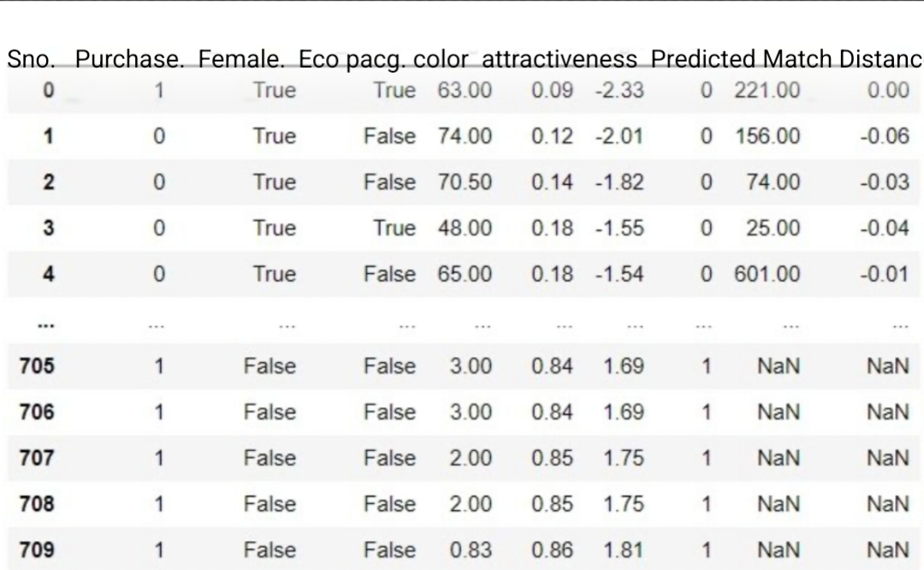
Propensity score matching

Slide 12
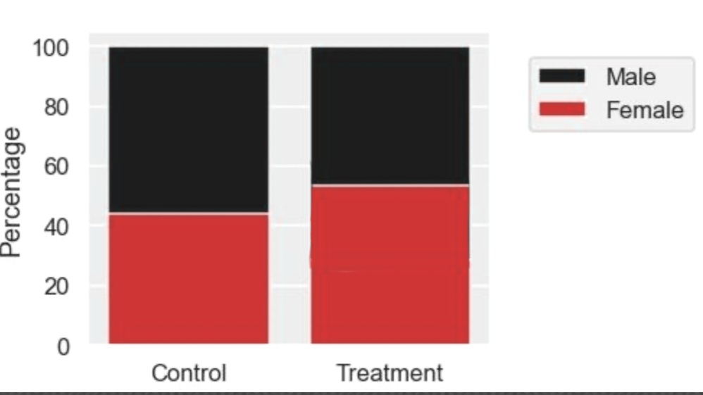
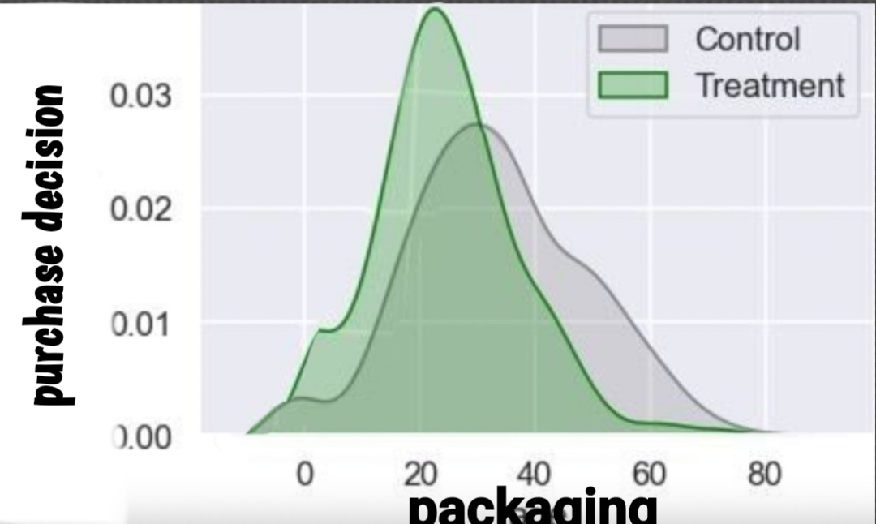
Bars and interpretations

Slide 13
Interpretations
The survey respondents was almost gender equal.
The treatment ground was divided with equal male and female respondents who were educated with nutritious effects of packaging and then run with audio visuals from latest climate summit as an generous appeal to save the planet.
The symmetry of the treatment group was higher and sharper.
Propensity score as a matching method was used to keep the desired variables.

Slide 14
Summary and Findings
Communication and Convenience is a blend of 2 most important weapons in marketing armoury.
Deduction and reduction of the philosophy states that Shape of the package is a significant contribution of communication through the packaging design.
The study admits proportional weightage to the Protection feature of packaging phenomenon.
The DID, regression and PS test showed that the respondents were more inclined towards the packages like Coke, Maggi, Attractive Shoe Packages and Attractive Polybags.

